Slide 1
Java Web Service using Spring - GetCheckID
Java Web Service – getCheckID
The purpose of this web service is to return from the check [Chk] table the Check ID [ID] when given the original ID [OrigID] as input.
Usage:
This service can be run in two modes. The mode that is used is determined by the format of the url that is entered into the web browser or calling program. The different formats are sent to the web server as either a html get or html post operation.
Mode 1 - To be used operationally returns XML (html get). http://localhost:8080/getCheckID/getOrigChkID?OrigID=8224
Mode 2 – Useful for testing return a normal HTML web page (html post). http://localhost:8080/getCheckID/getOrigChkID.html
The URL format differences are highlighted above.

Slide 2
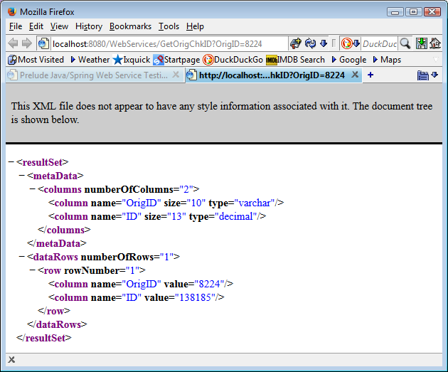
Java Web Service using Spring - GetCheckID
Calling Sequence Mode 1 – Example returns XML http://localhost:8080/getCheckID/getOrigChkID?OrigID=8224

Slide 3
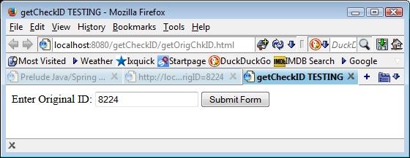
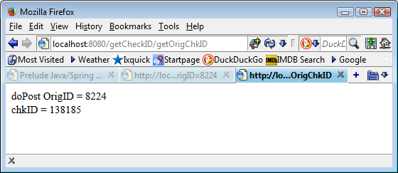
Java Web Service using Spring - GetCheckID
Calling Sequence Mode 2 – Example returns web page http://localhost:8080/getCheckID/getOrigChkID.html

Slide 4
Java Web Service using Spring - GetCheckID
Overview
The web service GetCheckID is:
Written in Java.
Uses the Spring framework.
Runs under the Apache Tomcat web server.
Open source solution.
Spring was used because:
One of the most popular and widely used Java Frameworks and easily does what we need.
A small xml configuration file allows you to specify the database connection information.
The database information can be changed by updating the XML file.
No changes to the code are needed.
Spring manages most of the database overhead, resulting less code having to be written and maintained.
Upon initialization Spring creates and maintains the connection to the database.
The Spring JDBC template manages the overhead in creating and executing SQL statements.
The Spring JDBC template also manages creating and navigating through the result set.
Handles exceptions that may be thrown when an error occurs.
The application code we write is less complex.
The same code will run on multiple platforms (Linux / Windows)
The same code will against multiple databases (Microsoft SQL / Oracle / etc.) as long as the code is written using standard SQL and uses no vendor specific extensions.

Slide 5
Java Web Service using Spring - GetCheckID
Design Overview
Application Program
Makes a web service request
http://localhost:8080/getCheckID/getOrigChkID?OrigID=8224
1
Web Server
(Apache TomCat)
5
2
4
Web Servlet
(GetOrigChkID)
Application program makes request to web server. http://localhost:8080/getCheckID/getOrigChkID?OrigID=8224
Web Server executes the Web Servlet (Java/Spring).
Web Servlet retrieves data from database.
Web Servlet returns XML data to Web Server.
Web Server returns XML data to the Application Program.
Database
3
More detailed information is stored with the source code as JavaDoc web pages.

